Slide 1
CIS 4517/5517:
Data Intensive and Cloud Computing
Virtualization
Dr. Xubin He
Computer and Information Sciences
Temple University
Notes:
ECE6130: Computer Architecture, T.T.U

Slide 2
Outline
Virtualization
VMWare, (Xen and KVM)
Clique migration
Courtesy: Some slides are adopted and modified from, C. Borcea@NJIT and Y. Yin@HP.
.

Slide 3
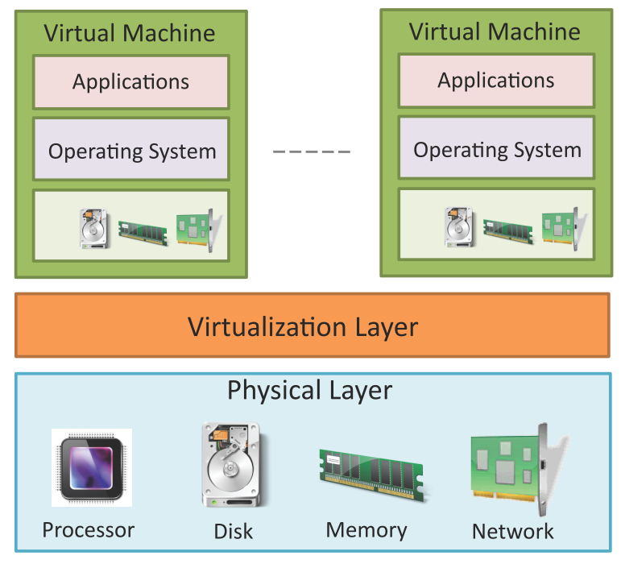
Virtualization
Virtualization refers to partitioning the resources of a physical system (such as computing, storage, network and memory) into multiple virtual resources.
Key enabling technology of cloud computing that allows pooling of resources.
In cloud computing, resources are pooled to serve multiple users via multi-tenancy.

Slide 4
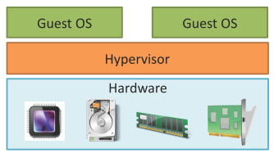
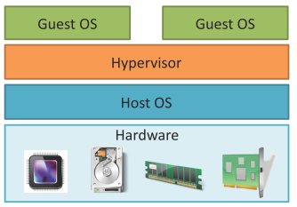
Hypervisor
The virtualization layer consists of a hypervisor or a virtual machine monitor (VMM).
Hypervisor presents a virtual operating platform to a guest operating system (OS).
Type-1 Hypervisor
  Type-I or the native hypervisors run directly on the host hardware and control the hardware and monitor the guest operating systems.
Type-2 Hypervisor
  Type 2 hypervisors or hosted hypervisors run on top of a conventional (main/host) operating system and monitor the guest operating systems.
Type-1 Hypervisor
Type-2 Hypervisor

Slide 5
Types of Virtualization
Full Virtualization
  In full virtualization, the virtualization layer completely decouples the guest OS from the underlying hardware. The guest OS requires no modification and is not aware that it is being virtualized. Full virtualization is enabled by direct execution of user requests and binary translation of OS requests.
Para-Virtualization
  In para-virtualization, the guest OS is modified to enable communication with the hypervisor to improve performance and efficiency. The guest OS kernel is modified to replace non-virtualizable instructions with hyper-calls that communicate directly with the virtualization layer hypervisor.
Hardware Assisted or Enabled Virtualization
  Hardware assisted virtualization is enabled by hardware features such as Intel’s Virtualization Technology (VT-x) and AMD’s AMD-V. In hardware assisted virtualization, privileged and sensitive calls are set to automatically trap to the hypervisor. Thus, there is no need for either binary translation or para-virtualization.

Slide 6
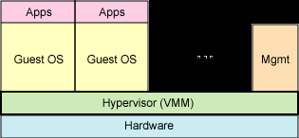
Full Virtualization
The virtual machine simulates enough hardware to allow an unmodified "guest" OS (one designed for the same CPU) to run in isolation.
Examples:
  VirtualBox
  Virtual PC
  Vmware
  QEMU
  Win4Lin
  XEN/Virtual Iron

Slide 7
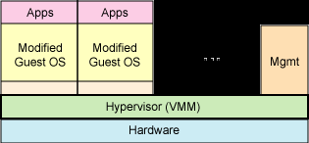
Para-virtualization
The virtual machine does not necessarily simulate hardware, but instead (or in addition) offers a special API that can only be used by modifying the "guest" OS.
Examples:
  XEN, KVM, Win4Lin 9x

Slide 8
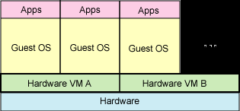
Hardware enabled virtualization
The virtual machine has its own hardware and allows a guest OS to run in isolation.
Intel VT (IVT)‏
AMD virtualization (AMD-V)‏
Examples:
  VMware Fusion
  Parallels Desktop for Mac
  Parallels Workstation

Slide 9
History of virtualization development
1965 IBM M44/44X paging system
1965 IBM System/360-67 virtual memory hardware
1967 IBM CP-40 (January) and CP-67 (April) time-sharing
1972 IBM VM/370 run VM under VM
1997 Connectix First version of Virtual PC
1998 VMWare U.S. Patent 6,397,242
1999 VMware Virtual Platform for the Intel IA-32 architecture
2000 IBM z/VM
2001 Connectix Virtual PC for Windows
2003 Microsoft acquired Connectix
2003 EMC acquired Vmware
2003 VERITAS acquired Ejascent
2005 HP Integrity Virtual Machines
2005 Intel VT
2006 AMD VT
2005 XEN, VMWare Player
2006 VMWare Server
2006 Virtual PC 2006
2006 HP IVM Version 2.0
2006 Virtual Iron 3.1
2007 InnoTek VirtualBox
2007 KVM in Linux Kernel
2007 XEN in Linux Kernel
2008 VMWare Workstation 6.5
2013: Docker opensource
2016: Dell acquired EMC
Source: https://en.wikipedia.org/wiki/Timeline_of_virtualization_development

Slide 10
The problem (1960’s)
Operating System
Mainframe Hardware
How to run multiple OS instances
on a mainframe?
  Main benefit: application isolation

Slide 11
The solution (1960’s)
Operating System
Operating System
Mainframe Hardware
Mainframe Hardware
Decouple OS from hardware

Slide 12
Virtual Machine Monitor (VMM)
App
App
App
App
Virtual machines
(VMs)
CMS
MVS
CMS
CMS
IBM VM/370
VMM
IBM Mainframe
A thin software layer that sits between hardware and the operating system, virtualizing and managing all hardware resources
  Instruction set, memory, interrupts, basic I/O

Slide 13
Two main problems
How to create the illusion of running directly on the hardware for VMs?
How to share resources among multiple VMs which expect resource ownership?

Slide 14
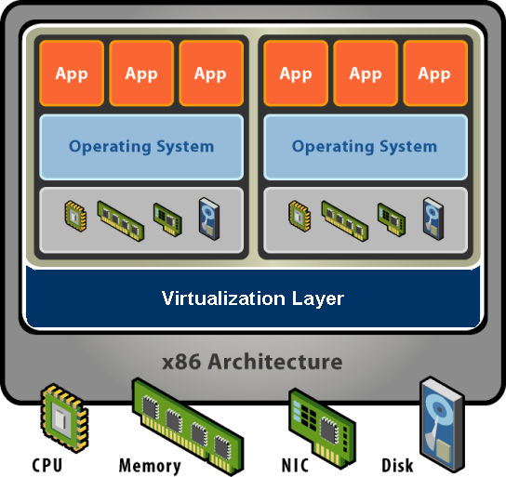
What exactly is a VM?
Software abstraction
  Behaves like hardware
  Encapsulates all OS and application state
    Unmodified OS (not aware of VMM)
Virtualization layer (VMM)
  Extra level of indirection
  Decouples hardware, OS
  Enforces isolation
  Multiplexes physical hardware across VMs

Slide 15
Virtualization properties
Isolation
  Fault isolation
  Performance isolation
Encapsulation
  Cleanly capture all VM states
  Enables VM snapshots, clones
Portability
  Independent of physical hardware
  Enables migration of live, running VMs

Slide 16
Virtualization applications
Server consolidation
  Convert under-utilized servers to VMs
  Significant cost savings (equipment, space, power)
  Increasingly used for virtual desktops
Simplified management
  Datacenter provisioning and monitoring
  Dynamic load balancing
Improved availability
  Automatic restart
  Fault tolerance
  Disaster recovery
Test and development

Slide 17
VMM operation
Takes complete control of the machine hardware
Creates virtual machines
Gets out of the way whenever possible and allows the virtual machine to execute directly on the hardware in a non-privileged mode
Regains control whenever the virtual machine tries to perform an operation that may affect the correct operation of other virtual machines or of the hardware
  Safely emulates the operation before returning control to the virtual machine
  This mechanism is called trap & emulate

Slide 18
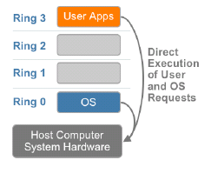
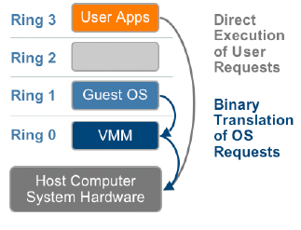
OS & VMM w.r.t. x86 privilege levels
No virtualization
Virtualization
Ring 0 is privileged kernel mode
Rings 1, 2, 3 are user level modes

Slide 19
Comparison of virtual machines
https://en.wikipedia.org/wiki/Comparison_of_virtual_machines

Slide 20
Outline
Virtualization
VMWare, (Xen and KVM)
Clique migration
Courtesy: Some slides are adopted and modified from Arshdeep Bahga & Vijay Madisetti, C. Borcea@NJIT and Y. Yin@HP.
.

Slide 21
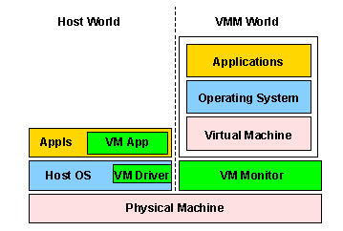
Original VMware hosted architecture
Co-exists with a pre-existing host operating system
Relies on host operating system for device support
Copes with diverse PC hardware and pre-existing PC software
VM

Slide 22
VMware workstation
Installs like a normal application on an operating system (host OS)
Components
  Application portion (VMApp)
  Driver in the host OS (VMDriver) – used by VMApp to establish VMM
  Privileged virtual machine monitor (VMM)
Switches between VMM world and host world (facilitated by VMDriver)
  Saves and restores user and system visible state on the CPU
  More heavyweight than a normal process switch

Slide 23
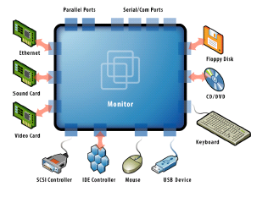
Access to physical devices
CPU virtualization is handled by VMM
  Pure computation runs in the VMM world
I/O Operations
  VMM must intercept all I/O operations issued by the guest OS
  On PCs, I/O generally done via special privileged IA-32 IN and OUT instructions
    Trapped by the VMM
      Operations that interact with the physical I/O hardware handled in the VMApp
      Operations that don’t interact with hardware handled by VMM

Slide 24
Overhead of I/O virtualization
World switches between the VMM and the host
Expense of handling the privileged instructions used to communicate with the hardware
These overheads are important for devices with
  High sustained throughput
  Low latency
Don’t matter for devices like keyboard

Slide 25
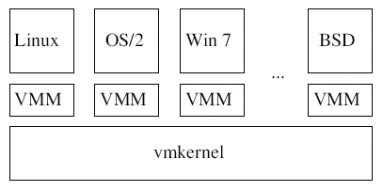
VMware full virtualization architecture
Hypervisor
  One vmkernel per host manages host-wide tasks
    Bootloader, X86 HAL, I/O stacks for storage/networking, memory & CPU schedulers
    Satisfies resource management and quality of service properties
  One VMM per VM
    Details of virtualizing specific x86 architectures
      E.g., binary translation done by VMM

Slide 26


I/O virtualization comparison
Hosted or Split
Hypervisor Direct
Guest OS
Guest OS
Device Driver
Device Driver
Host OS/Dom0/
Parent Domain
Device Emulation
Device Emulation
Device Emulation
I/O Stack
I/O Stack
Device Driver
Device Driver
VMware Workstation, VMware Server,
Xen, Microsoft Hyper-V, Virtual Server
VMware ESX

Slide 27
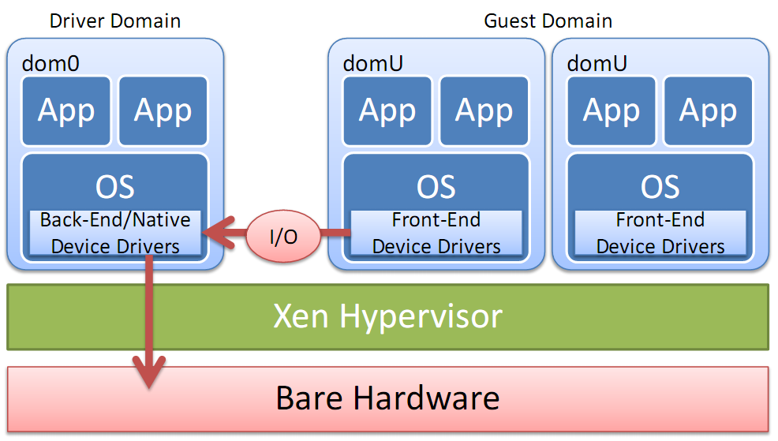
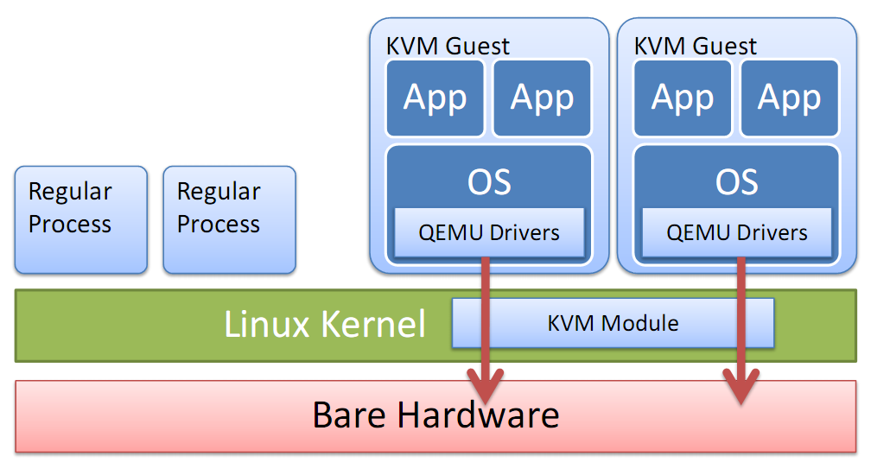
Xen¹ and KVM²
Xen
KVM
Xen runs closer to the bare hardware (full virtualization) , while KVM deploys virtual machines as processes (mainly Paravirtualization)
1 - http://www.xen.org, 2 - http://www.linux-kvm.org

Slide 28
More Resources
  KVM: linux-kvm.org
  Xen: www.Xen.org
  An introdcution to KVM: http://www3.nccu.edu.tw/~yuf/slides/kvm.pdf
  KVM architecture: https://vmsplice.net/~stefan/qemu-kvm-architecture-2015.pdf

Slide 29


Clique Migration: Affinity Grouping of Virtual Machines for Inter-Cloud Live Migration
Tao Lu, Morgan Stuart, Kun Tang, Xubin He
Department of Electrical and Computer Engineering
Virginia Commonwealth University

Slide 30
Problem Statement
Affinity is common among Virtual Machines in cloud environments. If VMs collaborating on a job are split in different geographically distributed clouds, the low bandwidth and high latency inter-cloud communication via a wide area network will dramatically degrade the system performance.

Slide 31
Inter-cloud VM live migration
Background Motivation Solution Evaluation Summary
Fault management
Load balancing
System maintenance
Network optimization
Notes:
The application scenarios of inter-cloud VM live migration

Slide 32
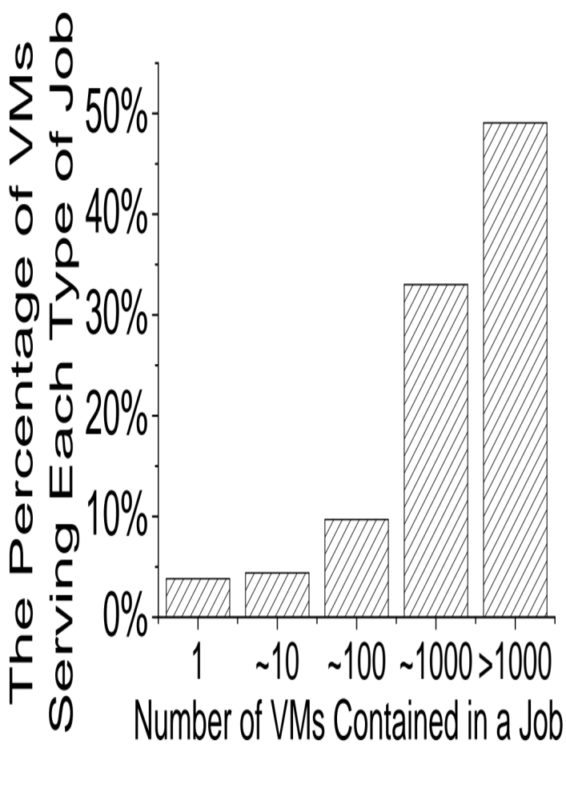
Google workloads
Background Motivation Solution Evaluation Summary
Fig 3: The collaborative behavior of VMs in Google workloads.
Notes:
Our analysis on Google Cluster Data show that more than 95% VMs in Google cloud platform are not working alone.
On average, a VM has 19.2 siblings (If VM B is collaborating with VM A on a same job, then we recognize VM A and VM B as siblings ), and 49.1% of the VMs have more than 1000 siblings.

Slide 33


How to migrate a large group of VMs?
Background Motivation Solution Evaluation Summary
VM 1
VM 2
WAN
VM 3
VM 4
Cloud A
Cloud B

Slide 34
Choice 1: Sequential migration
Background Motivation Solution Evaluation Summary
VM 1
VM 2
WAN
VM 3
VM 4
Cloud A
Cloud B
Problem:
During some migration periods, VM1-VM3, VM2-VM4 are connected through WAN, application performance during these periods will undergo serious degradation.
Notes:
Sequential Migration means migrating a group of VMs one by one. The problem is the collaborating VMs will absolutely separated at different sites during migration. And during the period when two VMs are separated, the communication performance between the two VMs will degrade considerably, as a result degrade the application performance.

Slide 35
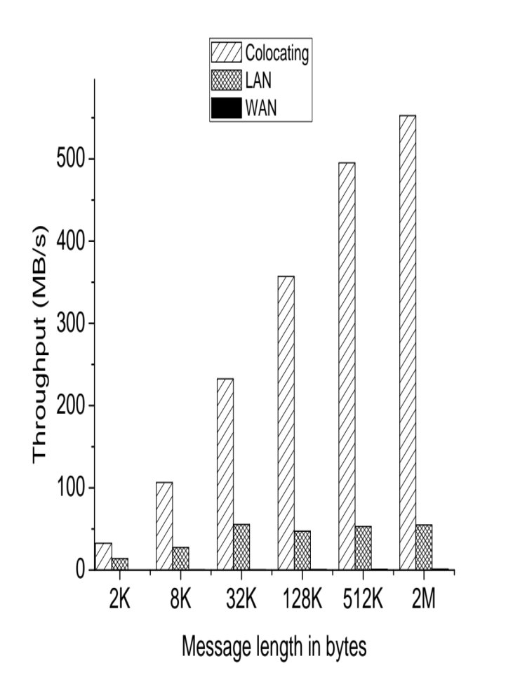
Network bandwidth dominates cloud applications performance
Background Motivation Solution Evaluation Summary
1.2MB/s
Fig 4: The Throughputs of Intel MPI Multi-PingPing benchmark using different network configuration.
Notes:
Using this figure, we want to prove that application performance really degrade a lot when lowing communication bandwidth. That’s why sequential migration is not good.
Co-locating VMs can utilize shared memory to communicate, thus yield the best throughput;
LAN is a 1Gbps network interconnection;
We use a 100Mbps network configuration to simulate WAN;

Slide 36
Choice 2: Parallel migration
Background Motivation Solution Evaluation Summary
VM 1
VM 2
WAN
VM 3
VM 4
Cloud A
Cloud B
Problem:
When the number of VMs need to be migrated is too large, the aggregate block dirty rate may overwhelm the limited WAN bandwidth, as a result, the live migration can’t converge.
Notes:
Parallel Migration means migrating a group of VMs all together at the same time. It can avoid wide area communication during migration. But the problem is when the total disk write rate is higher than the network bandwidth, migration can’t make progress.

Slide 37
Choice 3: Random Grouping (migrating a subgroup of VMs at a time)
Background Motivation Solution Evaluation Summary
VM 1
VM 2
WAN
VM 3
VM 4
Cloud A
Cloud B
Possible Choice 1 (best case)
Notes:
Random Grouping is a trade-off between Sequential Migration and Parallel Migration. The problem is without a smart grouping mechanism, it’s probable that two tightly related VMs are separated during migration, thus, cause degradation of application performance.

Slide 38
Choice 3: Random Grouping (migrating a subgroup of VMs at a time)
Background Motivation Solution Evaluation Summary
VM 1
VM 2
WAN
VM 3
VM 4
Cloud A
Cloud B
Possible Choice 2 (worst case)
Problem:
Random Grouping may still cause tightly collaborating VMs being split at different sites during migration.

Slide 39
Choice 4 (our focus): A smart grouping mechanism decides which VMs should be migrated together (right choice)
Background Motivation Solution Evaluation Summary
VM 1
VM 2
WAN
VM 3
VM 4
Cloud A
Cloud B
In this simple case, it’s obvious that VM1 and VM3 should be migrated together, also the VM2 and VM4.
However, in a complex system where the traffic affinities among VMs are not that obvious, how to decide which VMs should be migrated together?
Notes:
Our focus is a smart grouping mechanism decides which VMs should be migrated together (aim to always make right choice)

Slide 40
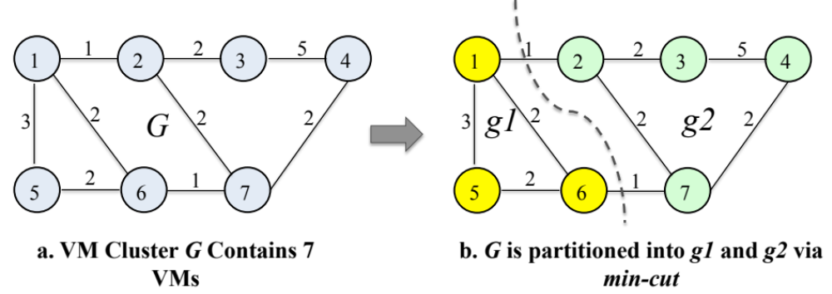
Clique Migration: partition a large group of VMs into several subgroups based on the traffic affinities among VMs to minimize inter-group traffic
Background Motivation Solution Evaluation Summary
Fig 5. Cluster G is partitioned into g1, g2 based on min-cut algorithm.
Notes:
This is an example show how our algorithm works. Our algorithm is based on Min-cut algorithm. Min-cut algorithm just works when a group of VMs are partitioned into two subgroups. To make the algorithm more general, we propose R-Min-Cut.

Slide 41




Formulation
Background Motivation Solution Evaluation Summary
Assume a group of VMs G need to be migrated from data center X to Y.
|G| is too large to be migrated all together simultaneously, G needs to be partitioned into n subgroups g_{i} (1 ≤ i ≤ n).
When migrating g_{i} (i ≥ 2 ), the subgroup sets and are split in data centers X and Y
During the migration of g_{i} , the total wide area communication volume V_{i} is denoted as (R indicates the traffic rate, and T indicates the time)
During the whole migration process, the inflicted wide area communication volume V is
We aim to minimize V.
Notes:
During migration, the wide area traffic rate are different from phase to phase, we aim to minimize the total wide area traffic volume caused during migration.

Slide 42
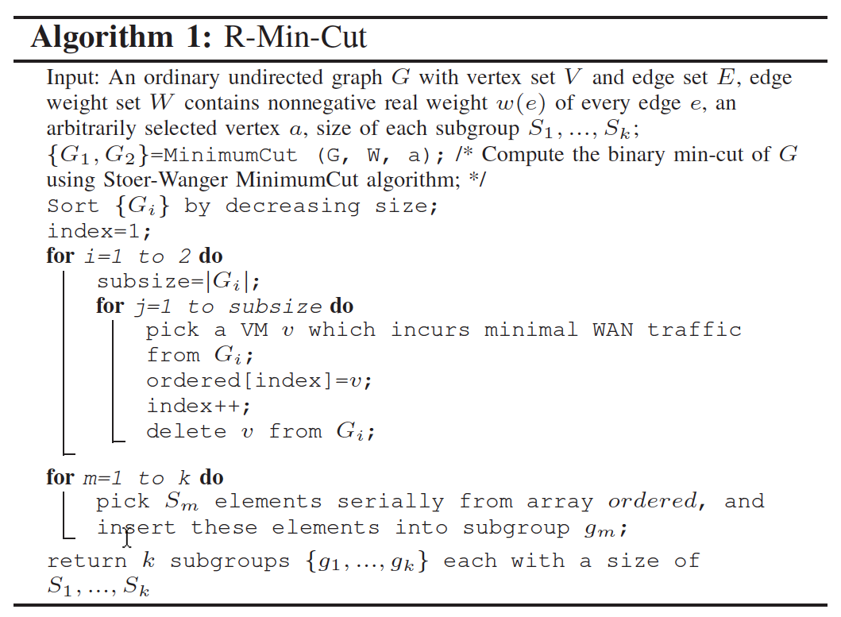
R-Min-Cut: Partition G into k sub-groups
Background Motivation Solution Evaluation Summary
Notes:
Based on min-cut algorithm, we separate a group of VMs into two subgroups. Then, we use a greedy algorithm to sort the order in which VMs should be migration. We take the traffic rate and phase time into consideration to minimize the traffic volume during migration. After the migration order is decided, no matter how many subgroup the VMs are partitioned, the grouping will obey this order.

Slide 43
Evaluation
Background Motivation Solution Evaluation Summary
Analysis on the IBM traffic trace of 68 VMs
Practical tests of MPI benchmark on 32-VMs testbed

Slide 44
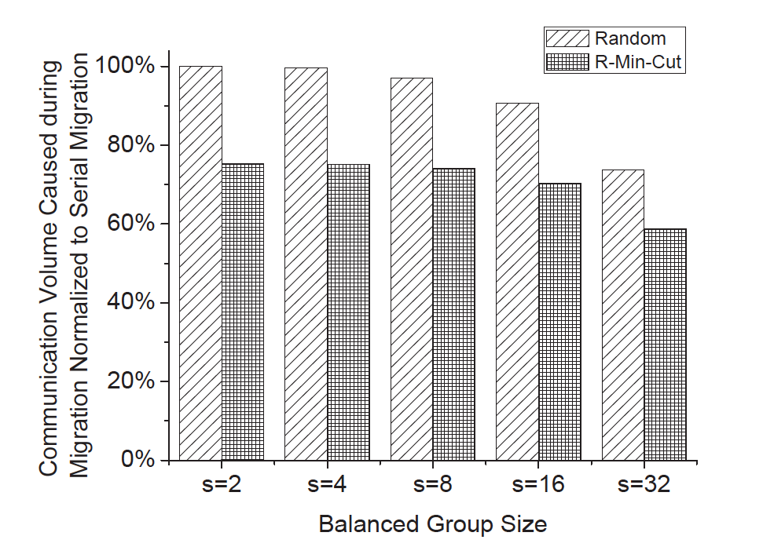
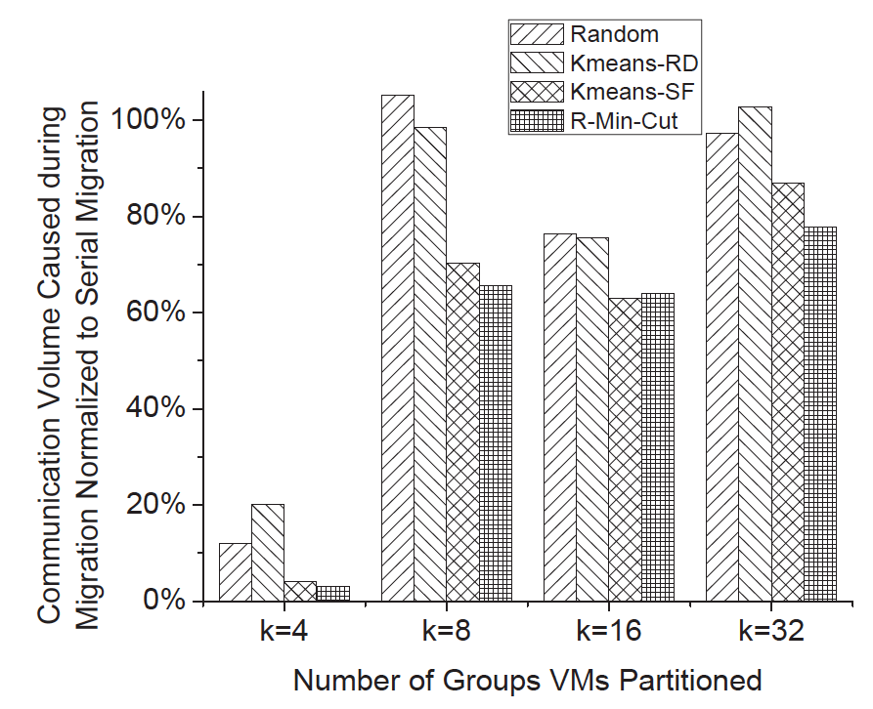
Analysis on IBM trace
Background Motivation Solution Evaluation Summary
Fig. 6. Comparison of traffic savings with different balanced group sizes.
Fig. 7. Comparison of traffic savings with different Grouping, and Shuffling
Mechanisms.
Notes:
Fig 6, we want to show that our R-Min-Cut algorithm is much better than Random grouping.
Fig 7, we compare each migration choice with sequential (also called serial) migration. Results show that most of the time, all of the methods have some benefits, an exception is random grouping, In some case random grouping may be worse than sequential. R-Min-Cut constantly performs well.

Slide 45
Analysis on IBM trace
Background Motivation Solution Evaluation Summary
Random grouping (the most naïve parallel migration) mechanism reduces communication volume by up to 26.4% compared to serial migration.
Parallel migration based on R-Min-Cut reduces the communication volume by 24.7% to 41.2% when the group size is 2 and 32 respectively.
R-Min-Cut outperforms random grouping by 37.0% on average and up to 74.4% when the total subgroup number is 4.

Slide 46
More resources
Cloud and virtualization concepts
Youtube Video:
  Virtualization in cloud computing

Slide 47
Next
Class projects posted
Next class:
  Distributed file systems
  Quiz 2: lectures 3,4,5

